Slide 1
Project 2 Map and Aggregation Visualization for India Demography
By:
Upendhar Rapolu
Ajay Kumar Kurapati
Ganesh Gurram

Slide 2
Objectives :
Using Maps and Aggregation Visualization analyze
below:
Analysis on different types of crops yielded in different states.
Analysis on different states population in India.
Analyzing ratios of employment and types of employment.

Slide 3
Data Set Used:
For this Project we are using a dataset which is -
Derived from publicly available sources, this dataset contains data on a variety of indicators from the years 2001 for India at three levels of administrative geography.
Thematic areas include: Business, Demographics, Economic Activity, Education, Environment, Finance, Health, Information Technology, Infrastructure, Jobs, Living Standards, Urban Extent.
Dataset is named project.csv( We are using Same Dataset which we used in Project 1 and Project 2 is Continuation for Project 1).

Slide 4
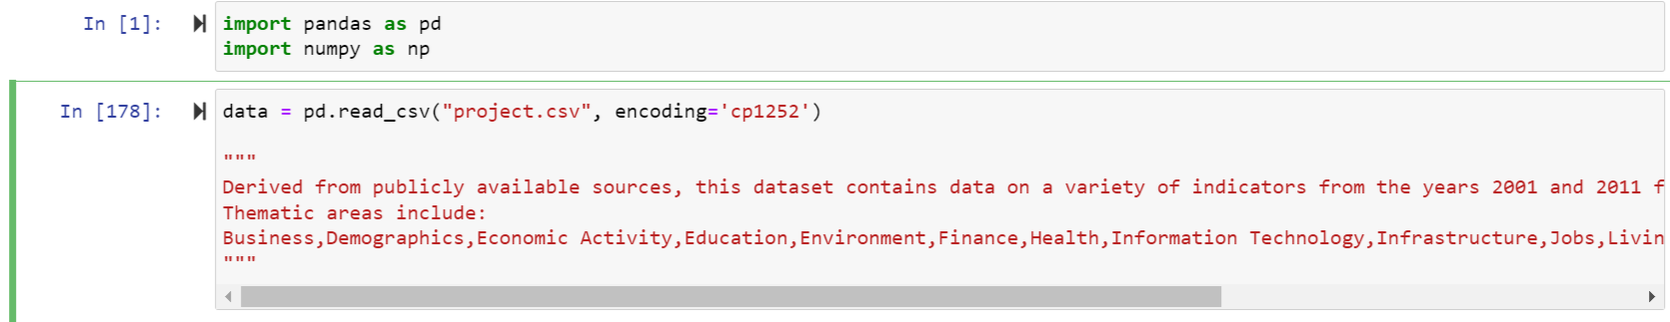
Data Loading :
We load the data using pandas ‘read_csv’ as below.

Slide 5
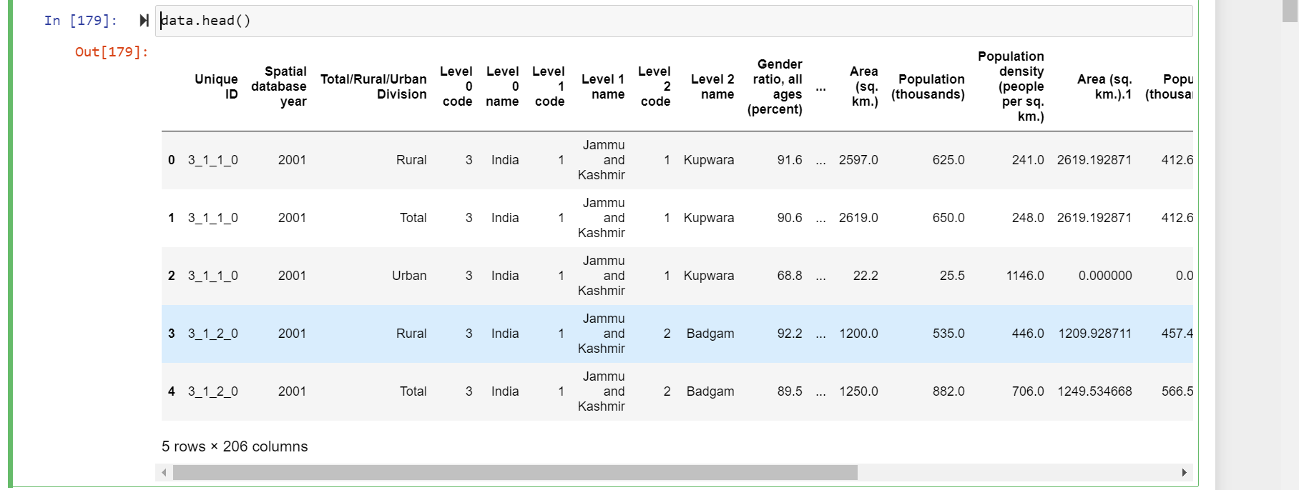
We can see the top 5 records as in below:

Slide 6
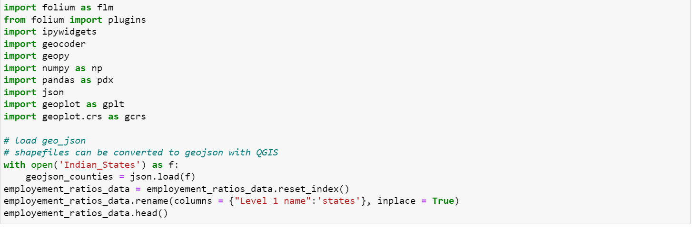
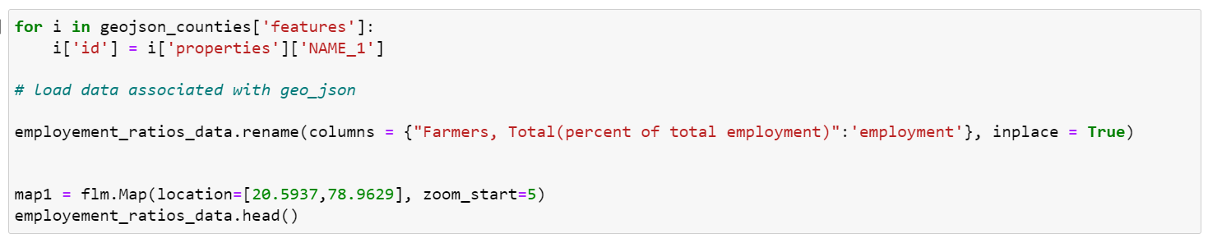
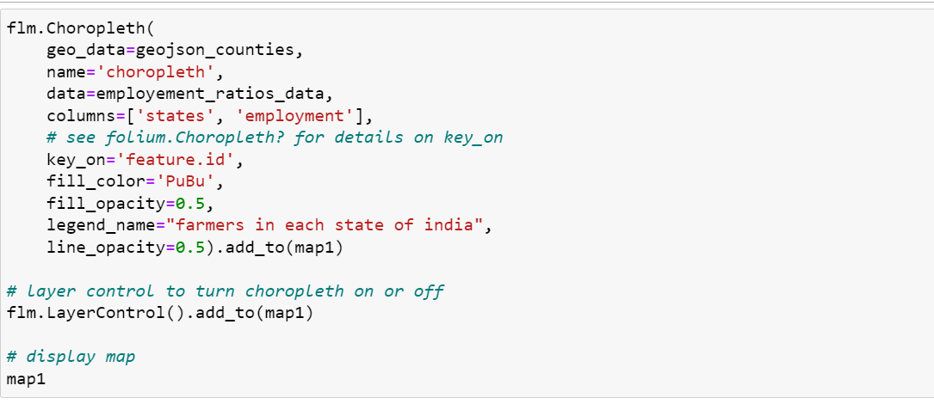
Choropleth Map:
We are using choropleth map to show the farmers of each state in India.
We are importing necessary required libraries.

Slide 7
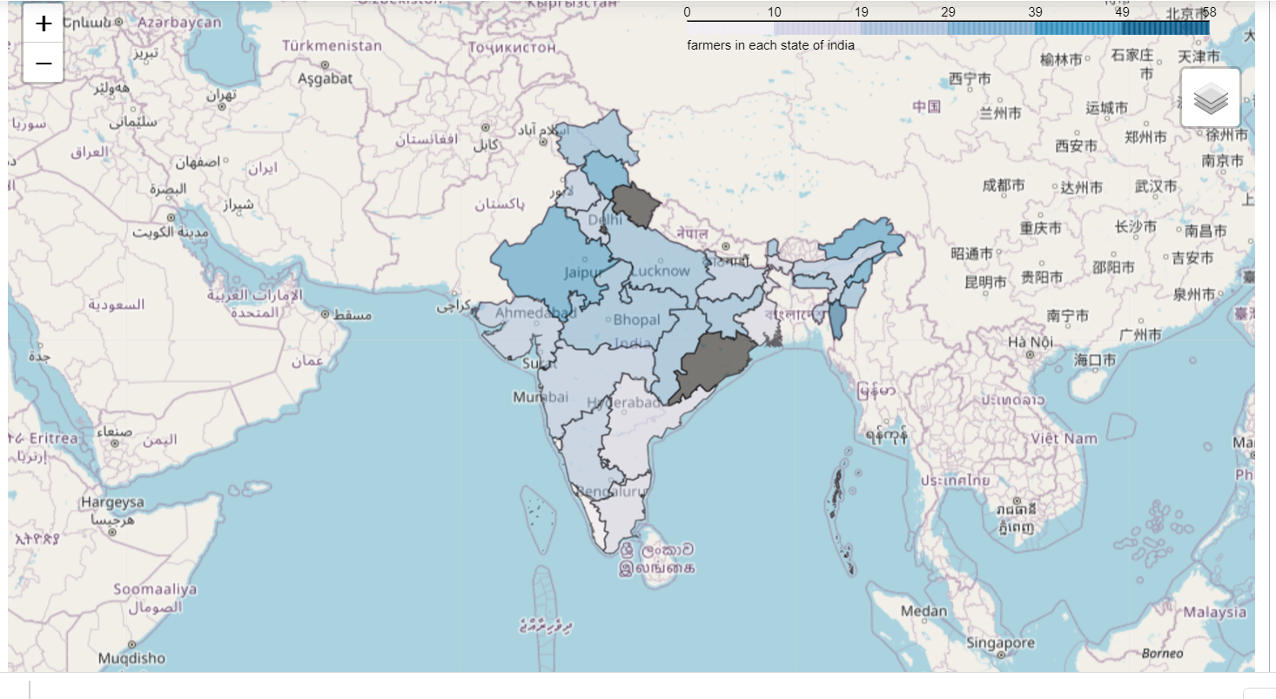
ChoroPleth Map:

Slide 8
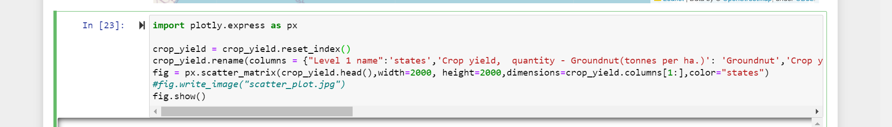
Scatter Matrix:
Scatter Matrix for the different types of crops yielded in different states in India.

Slide 9
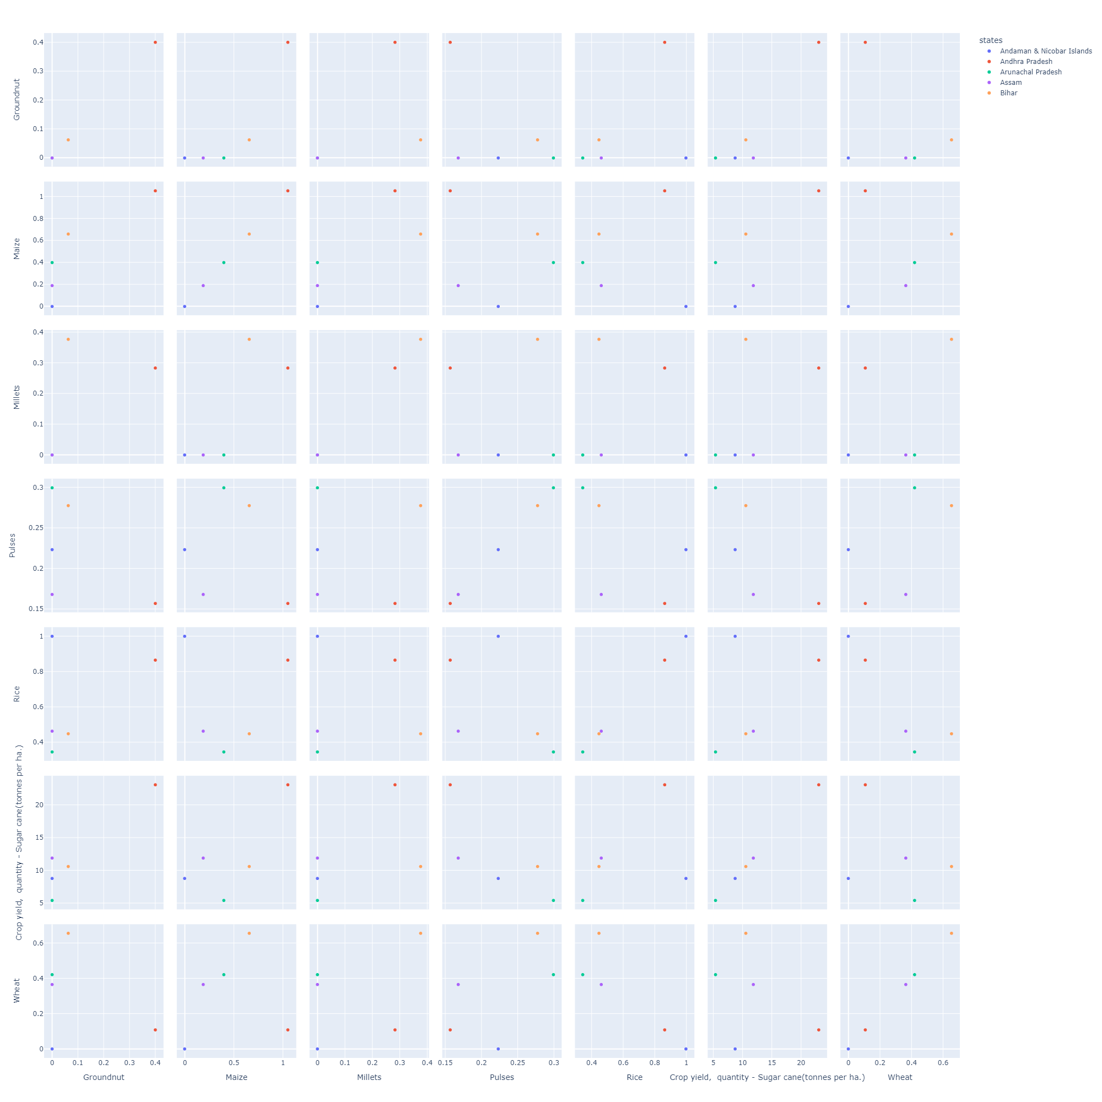

Slide 10
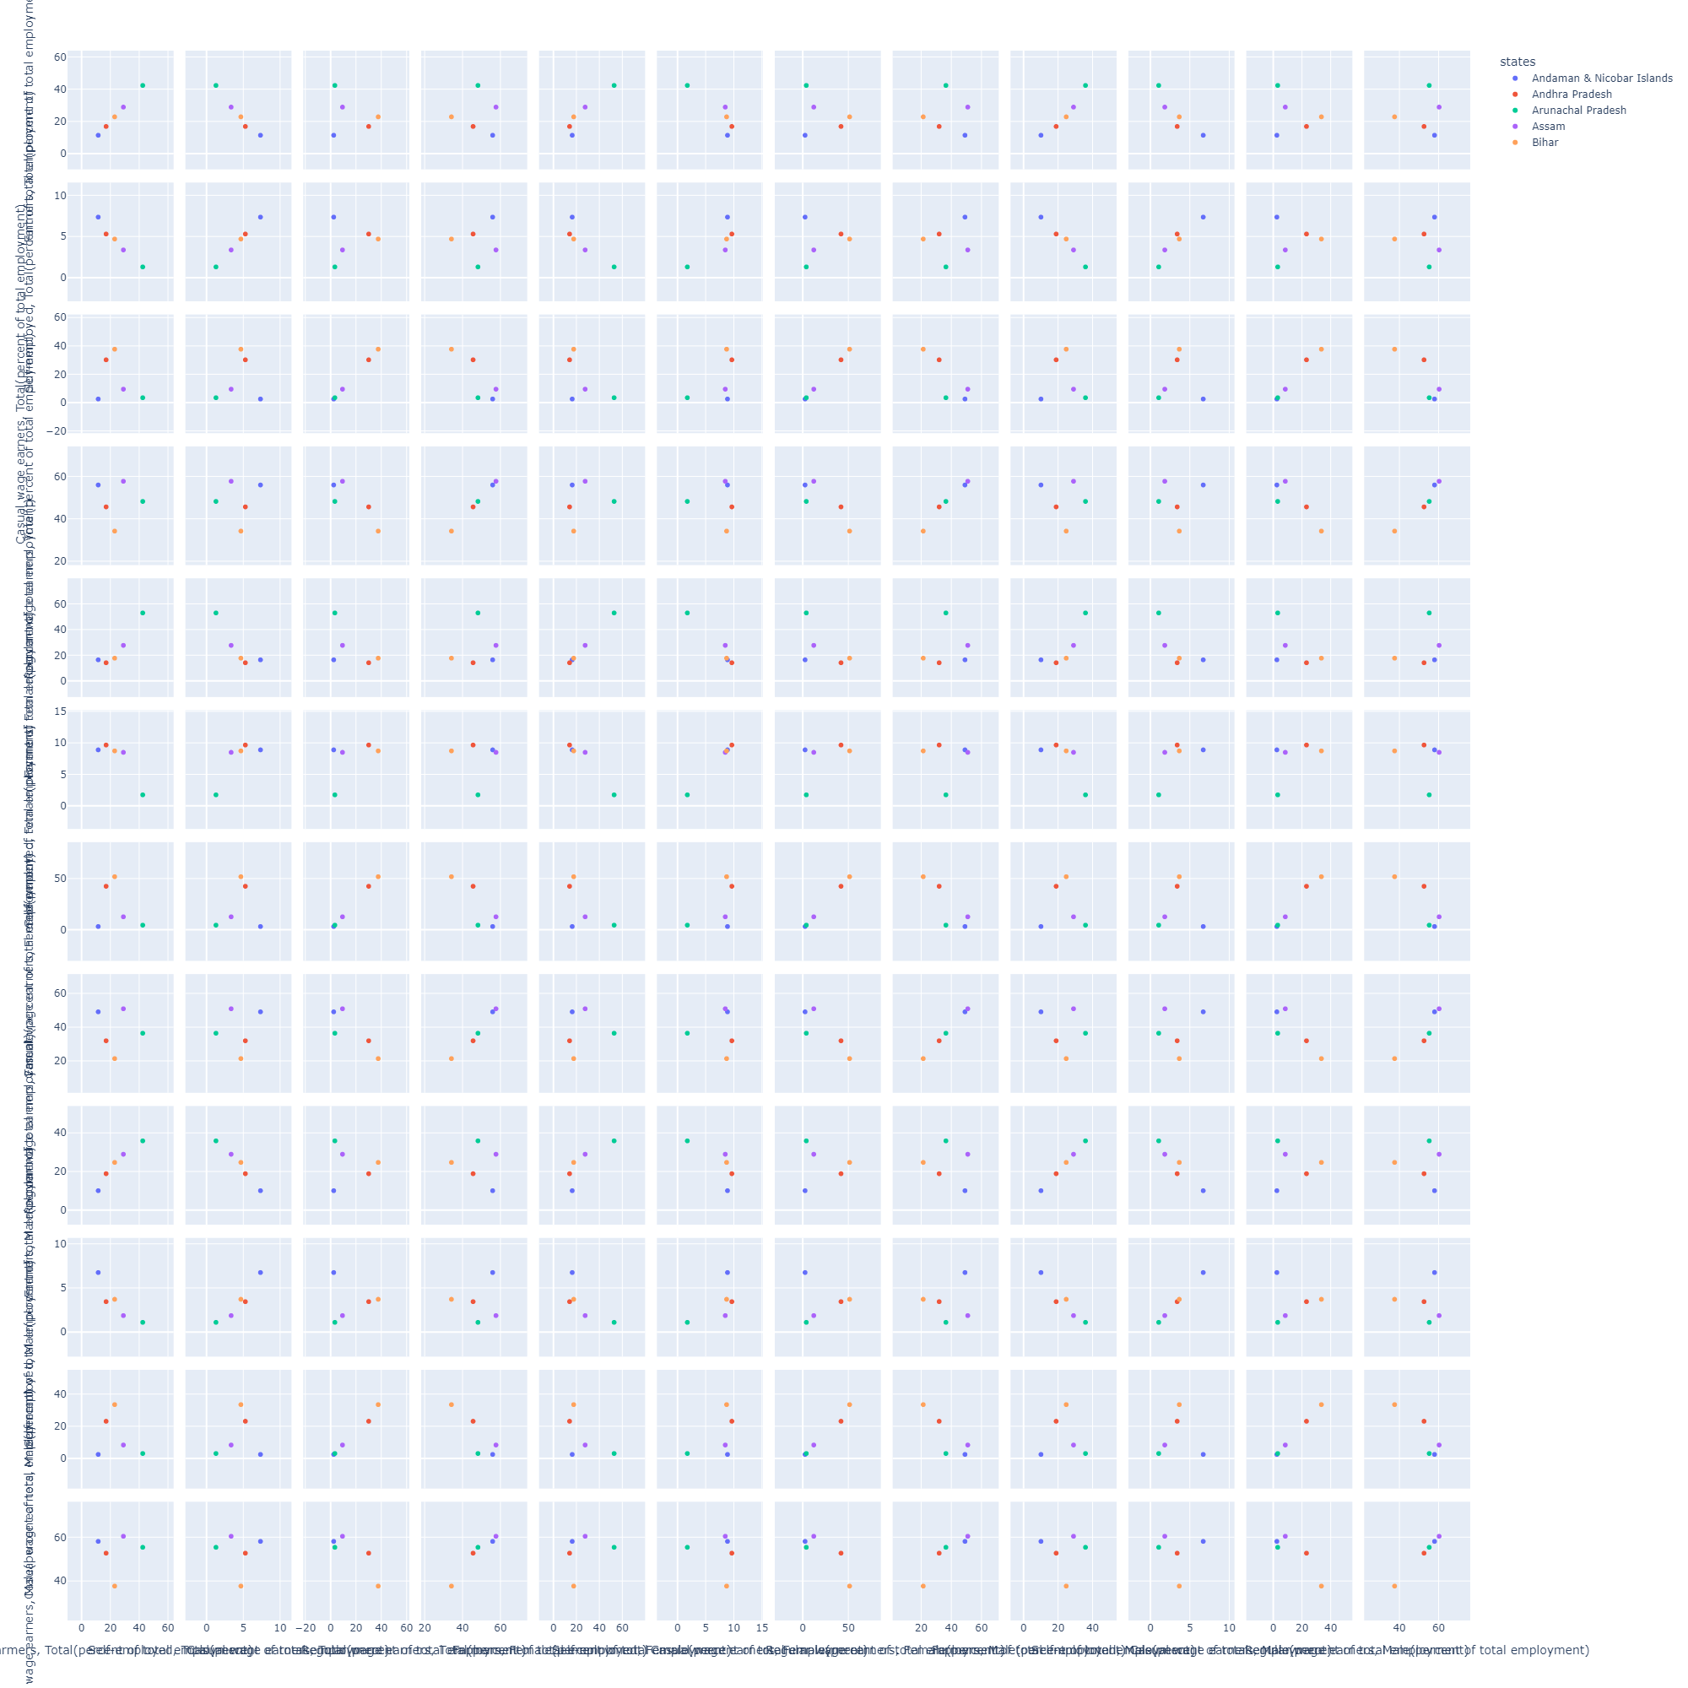
Scatter Matrix for the Employment ratios in different states of India.

Slide 11
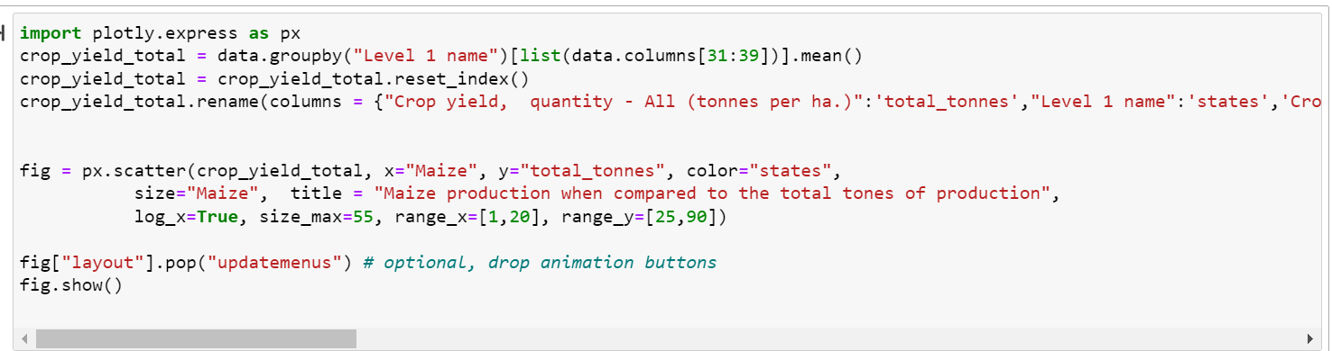
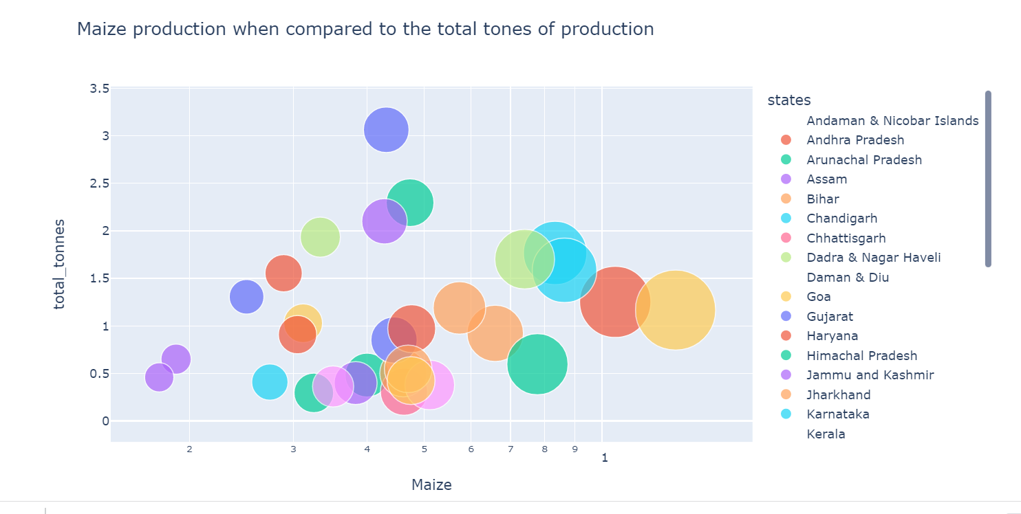
Dorling Cartogram: Dorling Cartogram for showing crop Maize yield of different states in India.

Slide 12
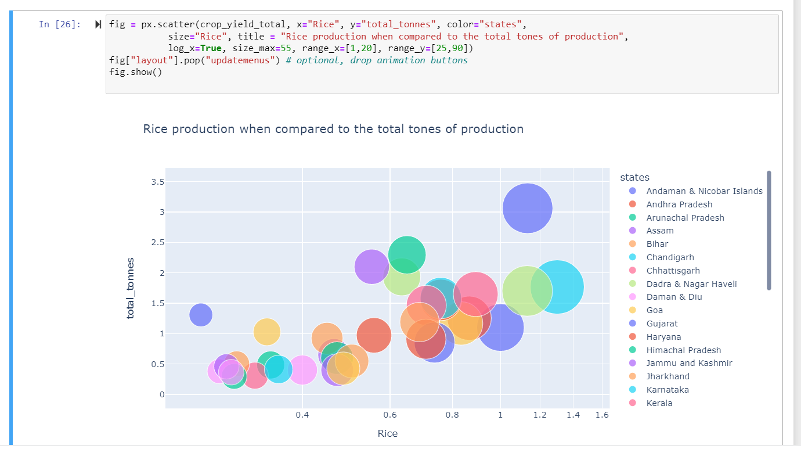
Dorling Cartogram for showing crop Rice yield of different states in India.

Slide 13
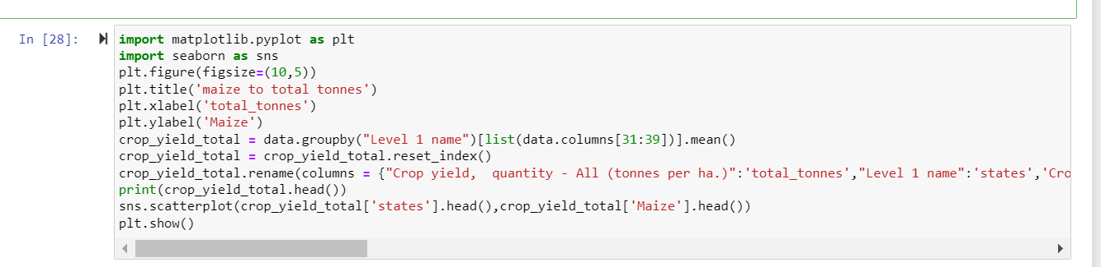
ScatterPlot:
We are showing the crop Maize yield when compared to all the crops yield in different states of India.

Slide 14
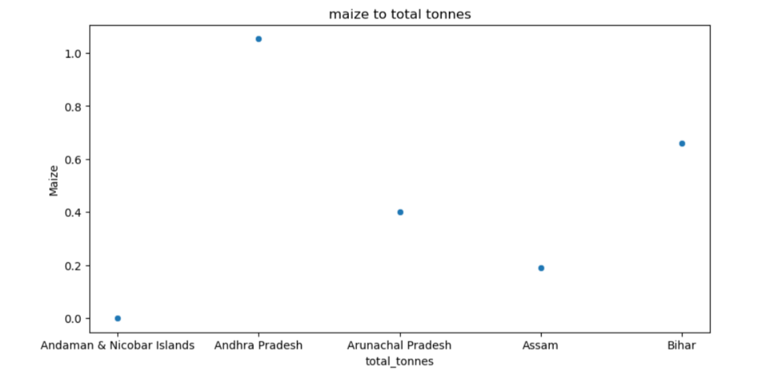

Slide 15
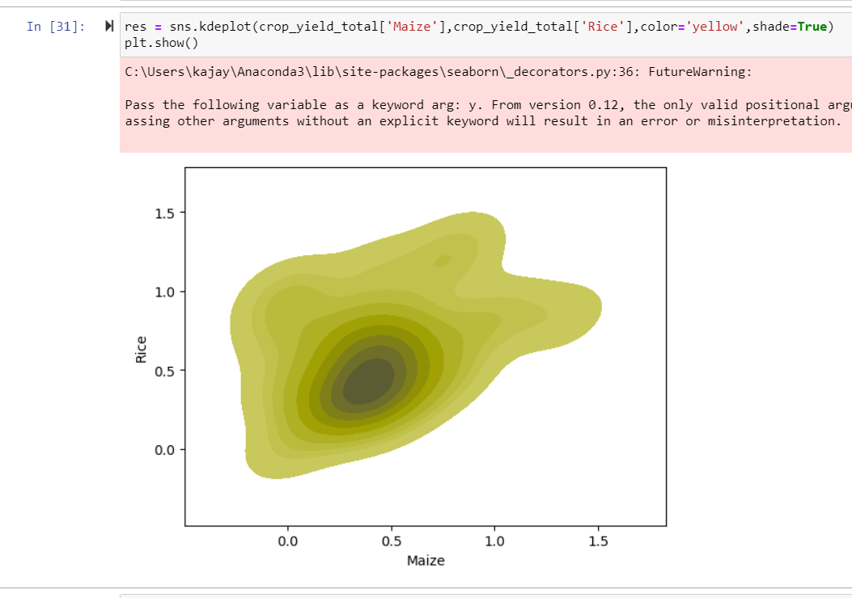
Density Plot(KDE): Density plot using KDE for Crops Rice and Maize

Slide 16
References: Data Set Reference from The Dataverse Project - Dataverse.org Conclusion: Using this data set we used different kinds of visualization techniques to show different crops yielded in various cities , total employment and types of employment and population density in different states in India.

Slide 17
Thank You

